Slide 1
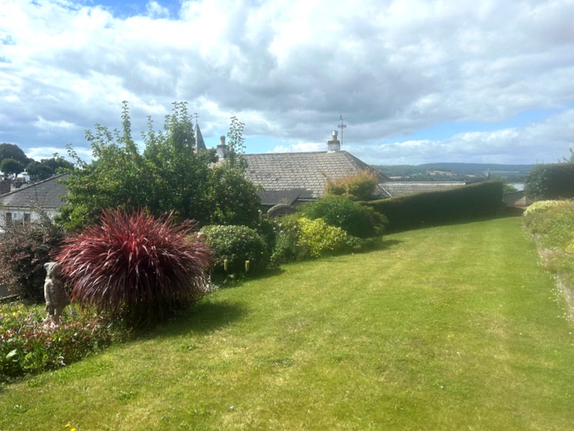
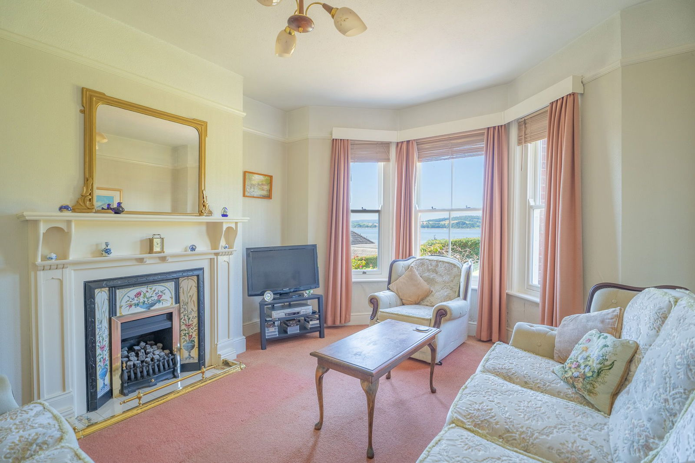
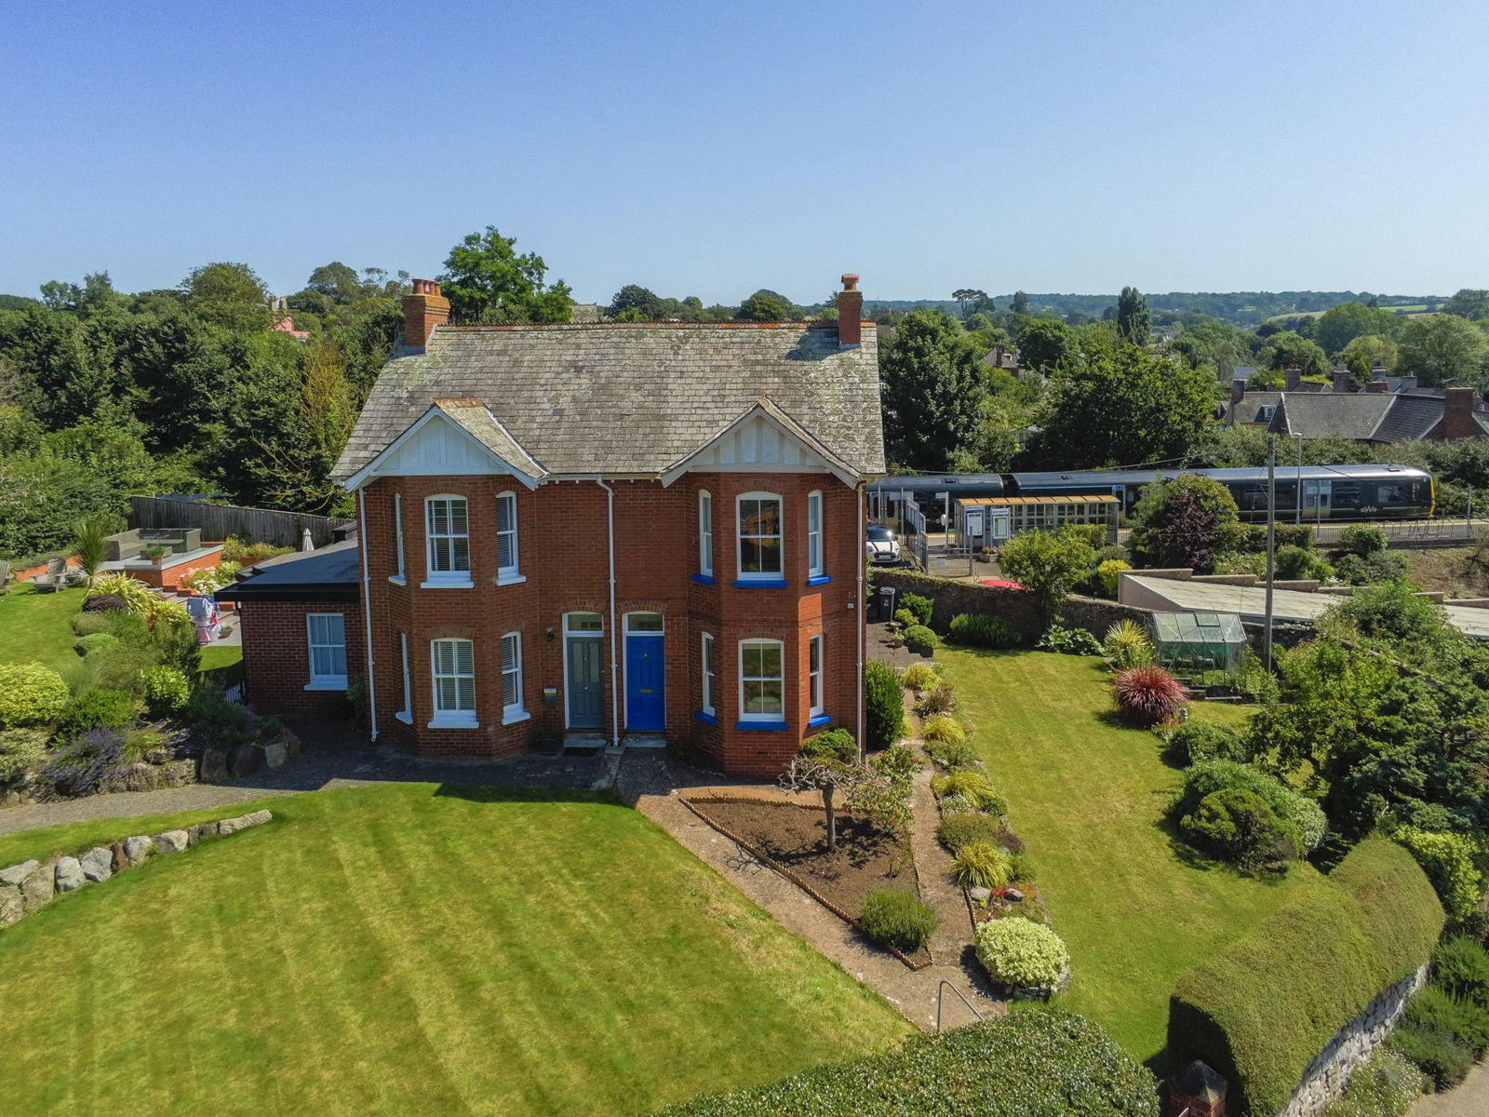
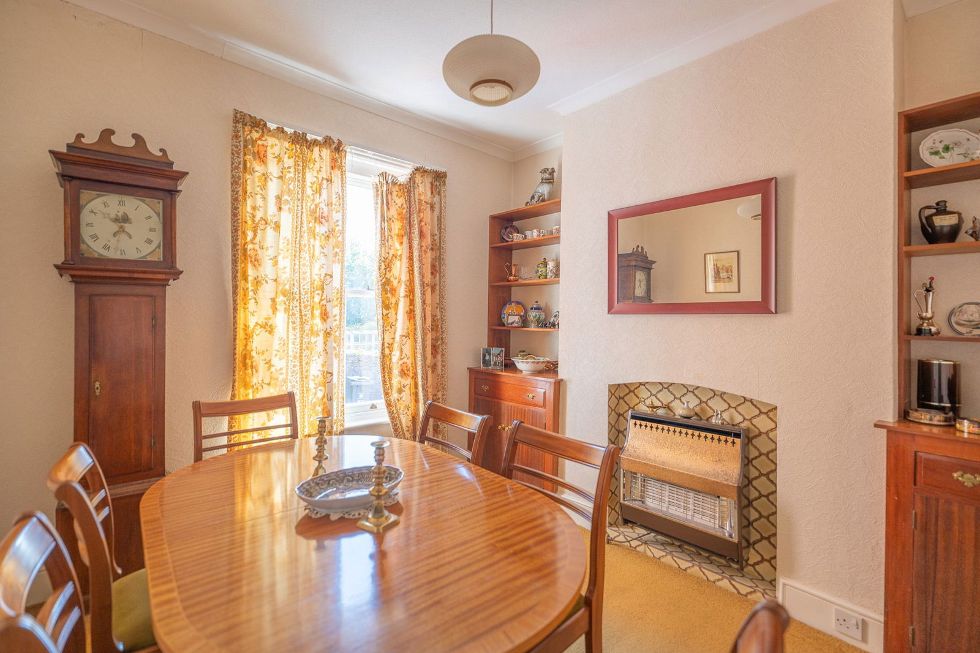
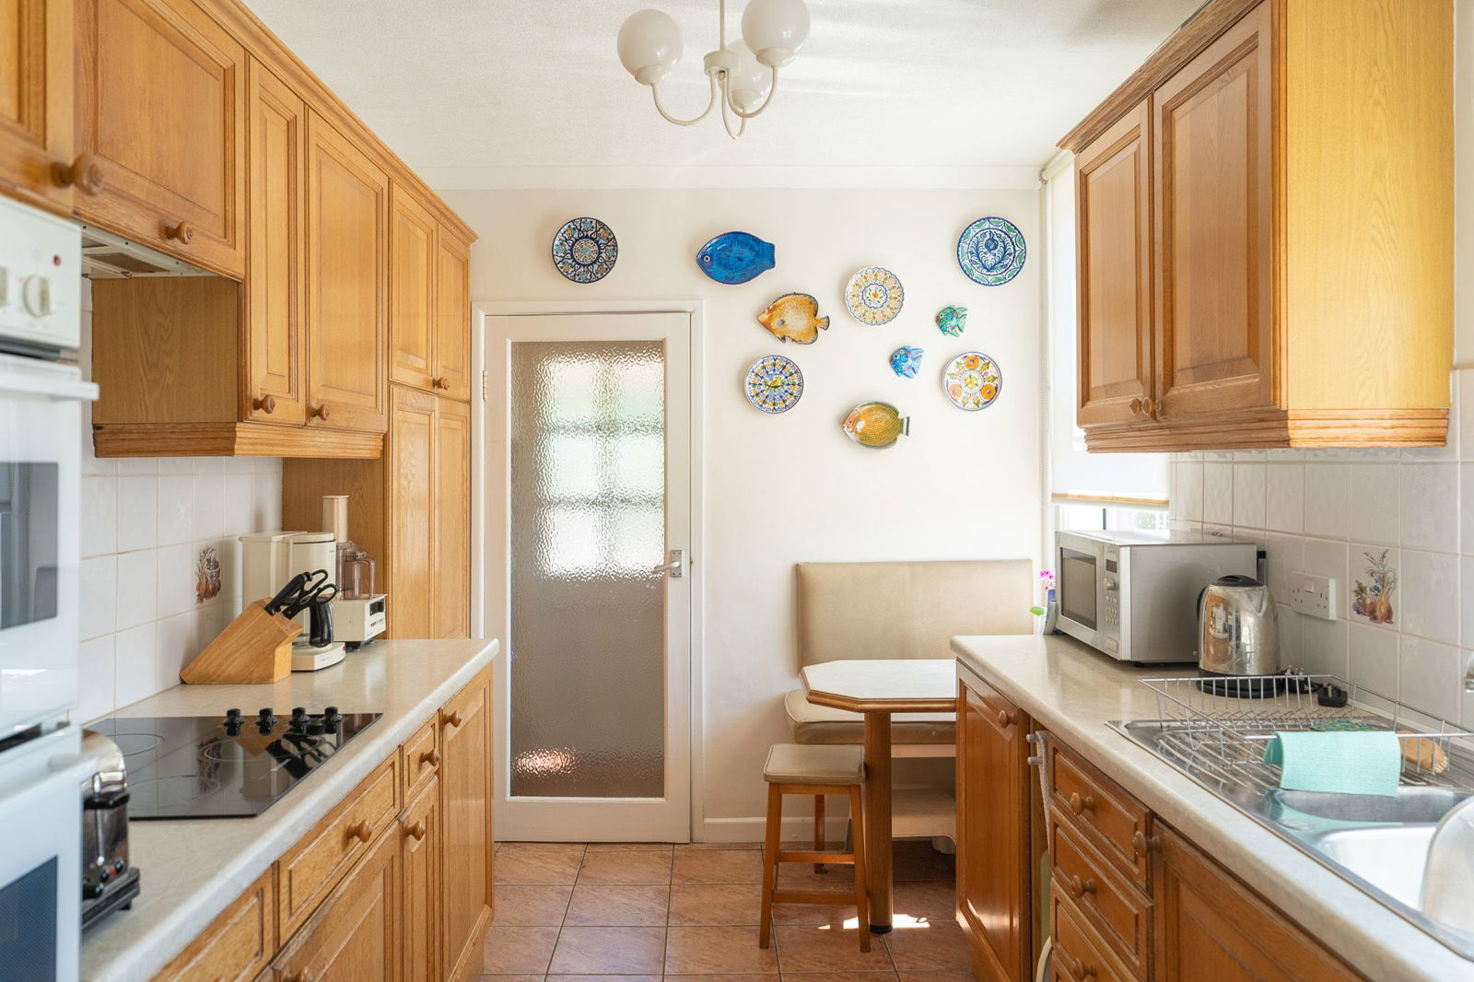
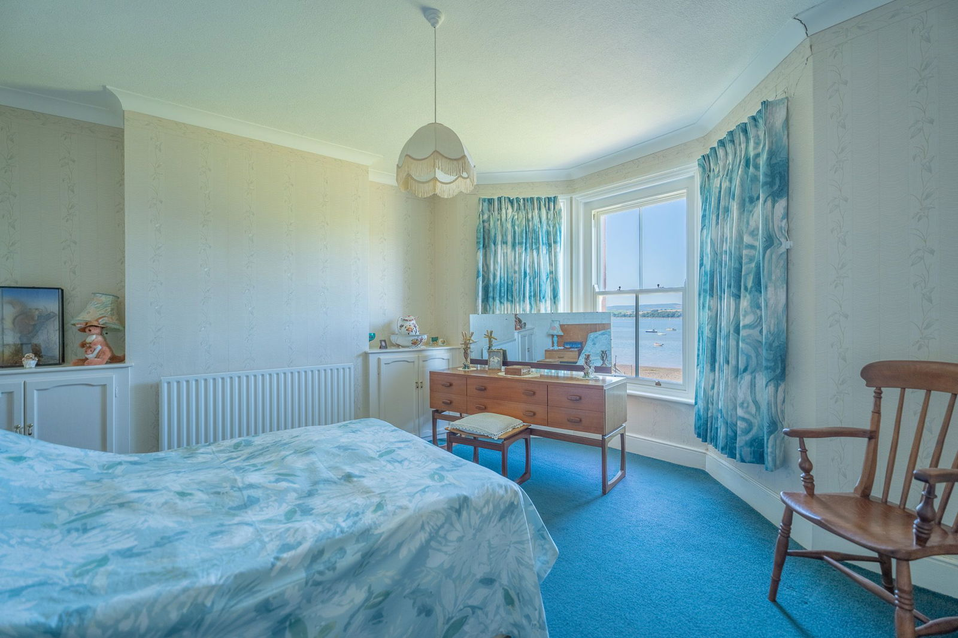
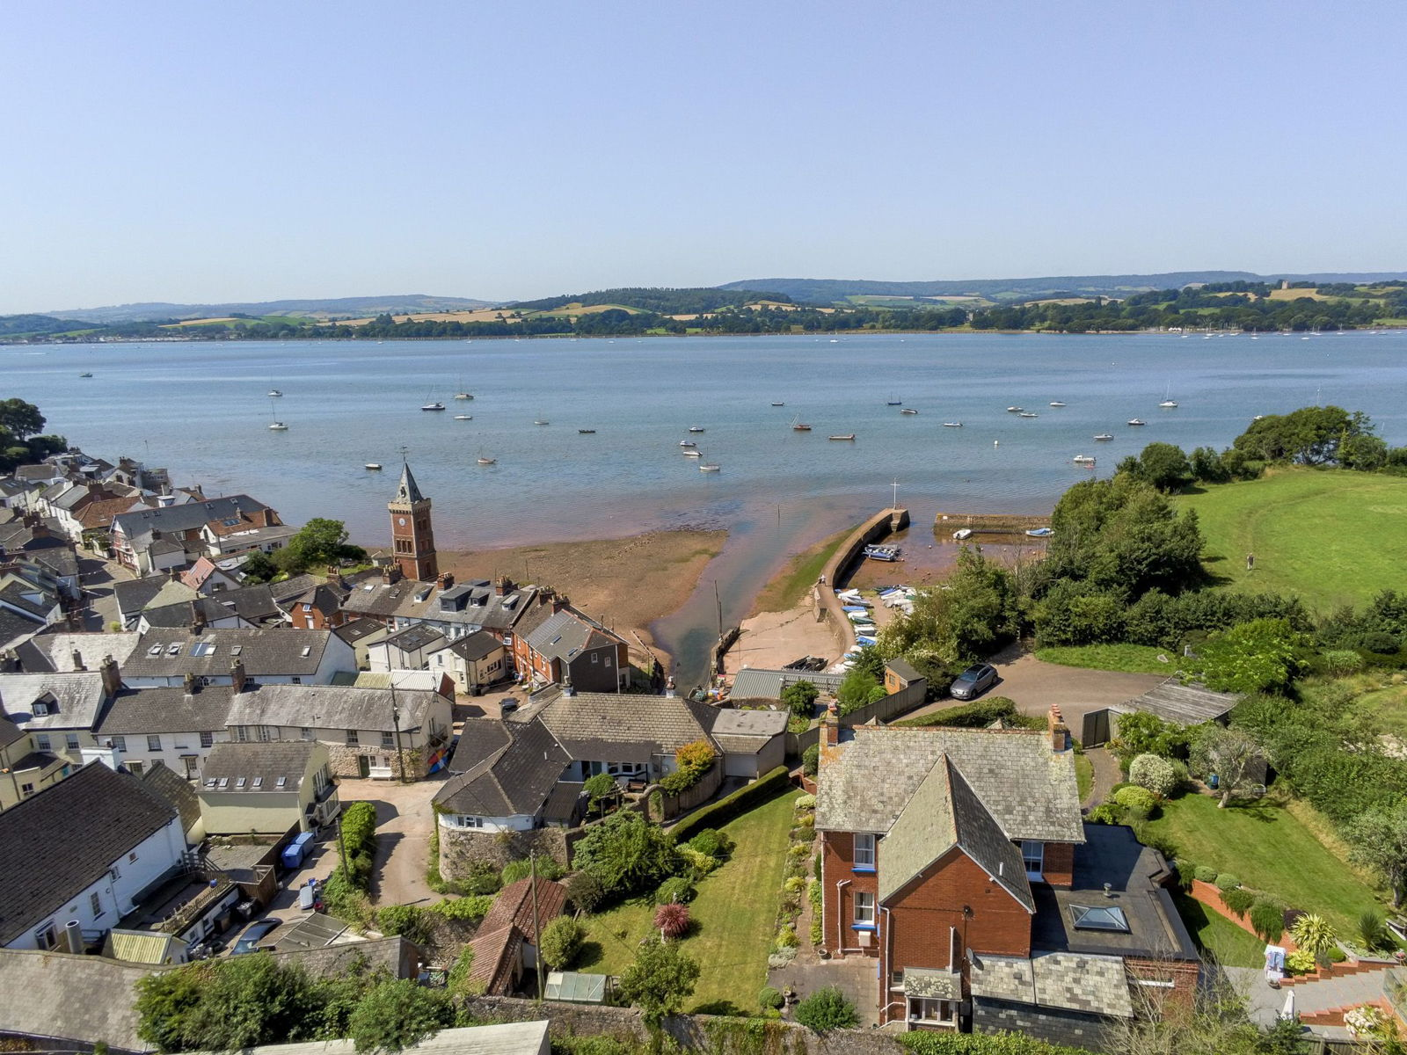
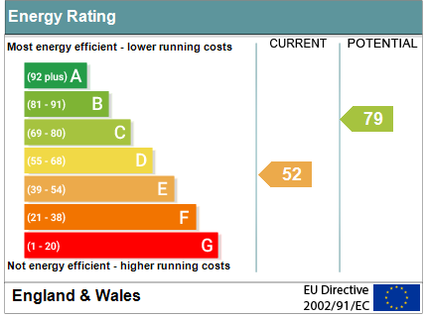
www.pennys.net
West View, Lympstone, Exmouth, EX8 5EU
GUIDE PRICE £625,000
TENURE Freehold
A Period Semi Detached House With Spectacular Estuary And Coastal Views Located In Heart Of The Sought After Village Of Lympstone
Entrance Vestibule * Reception Hall * Lounge * Dining Room * Kitchen * Ground Floor WC And Rear Porch * Two First Floor Double Bedrooms * Spacious Bathroom/Wc With Bath And Shower/Wc * Pleasant Gardens * Garage * Double Glazed Windows * Gas Central Heating * Characterful Accommodation Ripe For Improvement * No Ongoing Chain
Pennys Estate Agents Limited for themselves and for the vendor of this property whose agents they are give notice that:- (1) These particulars do not constitute any part of an offer or a contract. (2) All statements contained in these particulars are made without responsibility on the part of Pennys Estate Agents Limited. (3) None of the statements contained in these particulars are to be relied upon as a statement or representation of fact. (4) Any intending purchaser must satisfy himself/herself by inspection or otherwise as to the correctness of each of the statements contained in these particulars. (5) The vendor does not make or give and neither do Pennys Estate Agents Limited nor any person in their employment has any authority to make or give any representation or warranty whatever in relation to this property.
PENNYS ESTATE AGENTS
2 Rolle House, Rolle Street, Exmouth, Devon, EX8 2SN
Tel: 01395 264111 EMail: help@pennys.net

Slide 2
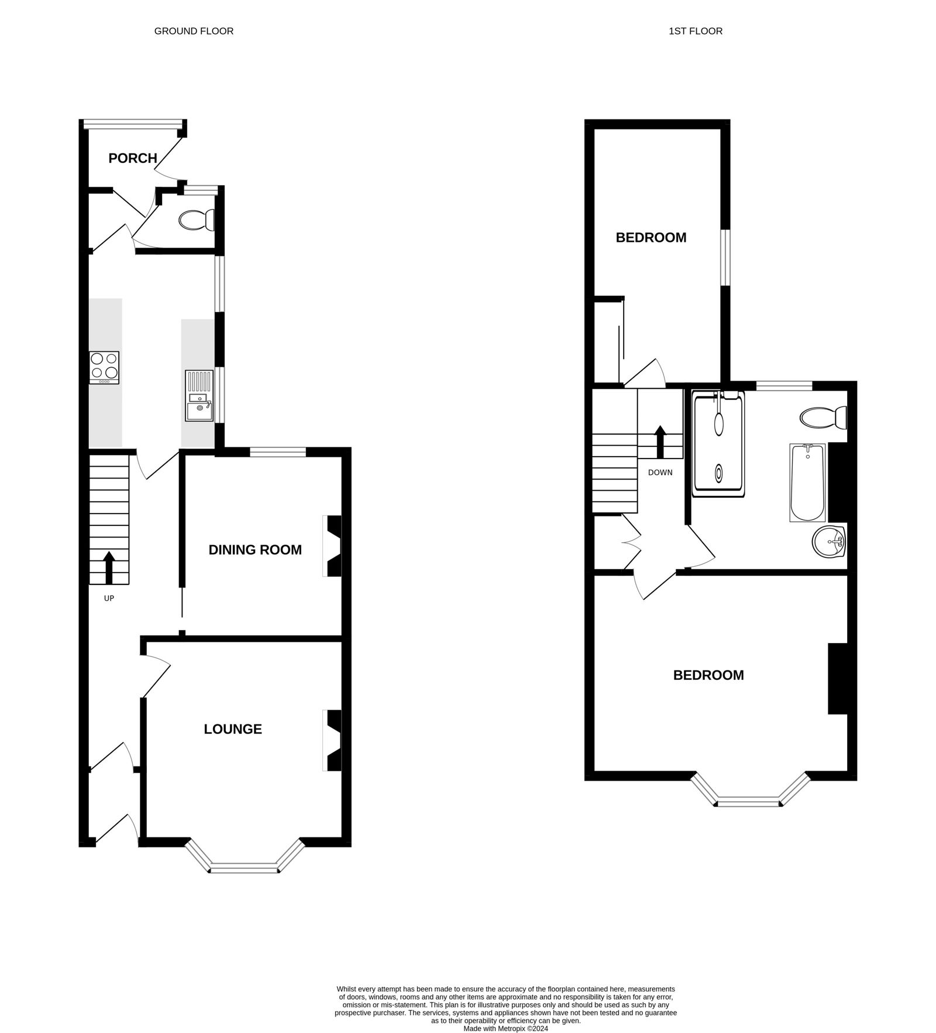
West View, Lympstone, Exmouth, EX8 5EU
Lympstone is a highly regarded village in the favoured Exe Estuary with an excellent range of local facilities including a sailing club, three pubs, village hall, general store, post office, primary and pre-schools as well as an independent preparatory school. There is a railway station connecting to Exeter. Nearby is the Exe Estuary Trail, the National Cycle path and walkway which runs around Exe Estuary linking Exmouth, Exeter and Dawlish. The centre of Exeter is 8.5 miles whilst junction 30 of the M5 motorway is 6 miles.
THE ACCOMMODATION COMPRISES: Solid wood front door to:
ENTRANCE VESTIBULE: With feature mosaic tiled floor, inner solid wood door with patterned glass to:
RECEPTION HALL: Radiator, staircase rising to first floor landing with useful understairs shelved recess and storage cupboard.
LOUNGE: 4.24m x 3.66m (13'11" x 12'0") maximum measurement into wall recesses. Replaced double glazed sash style windows overlooking the front aspect enjoying wonderful views to the estuary and coastline beyond, original fire surround with patterned tiled inset and hearth and housing living flame coal effect gas fire, TV point, picture rail, radiator.
DINING ROOM: 3.35m x 2.95m (11'0" x 9'8") With measurement into wall recesses, both fitted with dresser style units, fitted gas fire, replaced double glazed sash style window to rear elevation, radiator.
KITCHEN/BREAKFAST ROOM: 3.66m x 2.51m (12'0" x 8'3") Comprising; one and a half bowl single drainer sink unit set into work surface with cupboards, drawer units and plumbing for automatic washing machine beneath, built-in double oven and hob with extractor hood over, wall mounted cupboards, tiled surrounds, two uPVC double glazed window to side aspect overlooking the gardens, breakfast bar area with fitted seat, tiled flooring, door with patterned glass to:
REAR LOBBY: Wall mounted cupboard, tiled floor, door to outside and WC.
REAR PORCH: 1.91m x 0.91m (6'3" x 3'0") With light, double glazed windows, tiled floor and part glazed door to outside.
FIRST FLOOR LANDING: Access to roof space, fitted linen cupboard with drawer units beneath.
BEDROOM 1: 4.8m x 4.17m (15'9" x 13'8") maximum measurement into wall recesses and replaced double glazed sash style windows overlooking the front aspect enjoying magnificent views of the Exe estuary and coastline. Two fitted cupboards with display surface over housed in wall recesses, radiator.
BEDROOM 2: 4.6m x 2.39m (15'1" x 7'10") With replaced double glazed sash style window overlooking side aspect, radiator, built-in wardrobes with storage cupboards over.
BATHROOM/SHOWER ROOM/WC: 3.35m x 3.02m (11'0" x 9'11") A spacious bathroom comprising; bath with shower attachment, double width shower cubicle with sliding shower screen doors, splashback walls and Mira shower unit, vanity style wash hand basin with wall mounted mirror fronted medicine cabinet with display light, WC with concealed cistern and push button flush with matching storage cabinets over, heated towel rail, part tiled walls, double glazed replaced sash style window to rear aspect.
OUTSIDE: Enjoying a quiet yet tucked away village centre location, the property enjoys an elevated position to take full advantage of wonderful views at the top of a private drive. Approached by a pedestrian gate the property enjoys attractive flower and shrub beds directly to the front of the property, good sized lawned front and side gardens with a variety of shrubs and plants offering a variety of colour. To the side garden there is a rear patio sun terrace, outside cold water tap. Greenhouse and access to a substantial garden store. The property also benefits from a single GARAGE with up and over door. Wooden side gate with rear pathway giving rear pedestrian access to railway station (Paddington 3 hours, Waterloo 3.45 hours) and Cycle path.
FLOOR PLAN:

